Slide 1

Congratulations, Team Cherokee – You Rock!
01/2021 – 09/2021

Slide 2

Waves Supported In 2021
Started off the year in San Diego
Did an outstanding job with Carson & Carson+
Successfully overcame obstacles at TRIPLER, offering excellent support
MTK setup & groundwork at WBA & WLA
Preparation for WHO & WBR
Provided PCL for Beaumont/Gordon & Jacksonville / Eglin
WAY TO GO, TEAM!

Slide 3

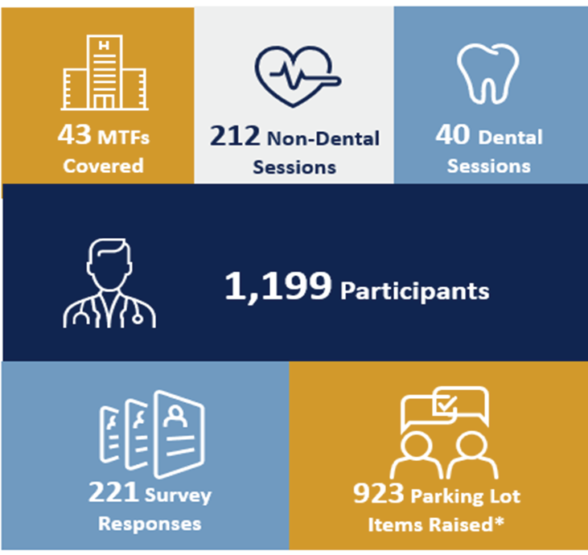
Clinical Support – You guys did an awesome job – Thank You!
Waves San Diego, Carson, Carson+, TRIPLER, USCG Atlantic, & USCG Pacific Total LPE’s: 80,268 Dry Lab Validations Completed Where Performed (TRIPLER presently at 99%)
Provider Adoption Accomplishments To Date (September 2021)

Slide 4
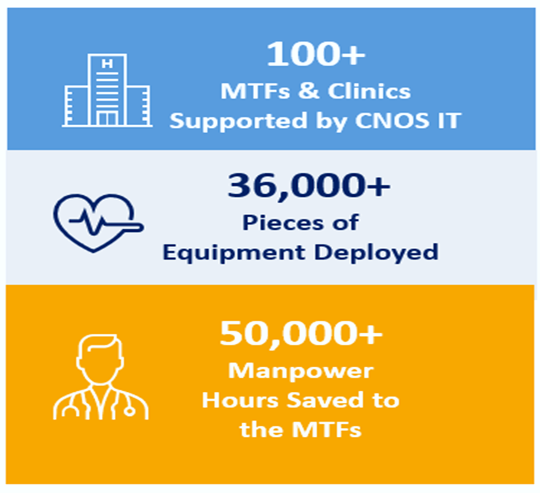

Our gratitude goes to IT Logistics for setting up the entire process.

Slide 5
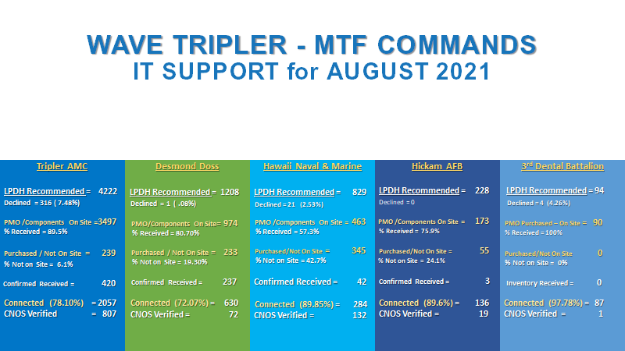

Slide 6
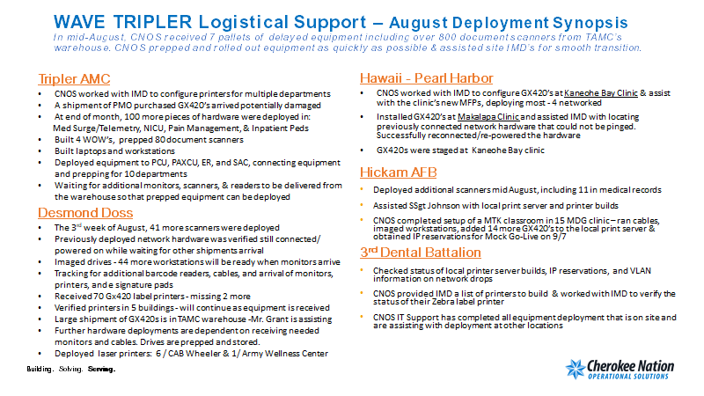

Slide 7
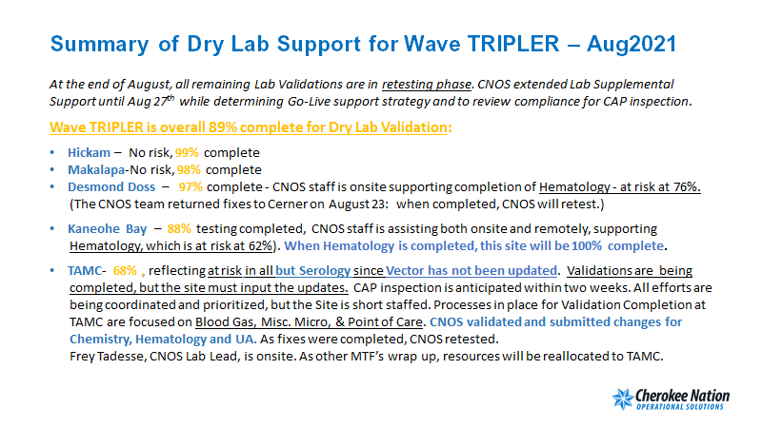

Slide 8

Reported Kudos for Team Cherokee - 2021
Kudos & sincere thanks to all of Team Cherokee who tirelessly worked to accomplish the tasks at hand & provide for spectacular customer service!
Danielle DeVita: For her excellent interaction with the COR and site management: “You are always providing epic services,” (Great Clinical Support Team) Merwynn Pagdanganan – DHMSM/ Wave TRIPLER, Hawaii
Frey Tadesse & Steve Xiong: “We would like to retain the services of Frehywet Tadesse and Steve Xiong to assist us further since their performance has exceeded expectations.”– Major Paul R. Ambrose, Wave TRIPLER
Frey Tadesse: – It was a pleasure to have Frey assist our team. She did an excellent job and set us up for success. – Major Paul R. Ambrose
Steven Flores: The 22nd Medical Group at McConnell AFB gave kudos to Steven Flores for his hard work, great attitude, and support provided during onsite deployment activities at Carson/Carson+.
Clint Strong: “Clint provided outstanding support during our transition to MHS GENESIS. He provided us with the knowledge and ability to get our equipment set up in a timely manner & helped us set up our COVID Clinic and testing areas.”
Minot AFB/Carson & Carson+

